Slide 1

Solving a Word Search
Design and Analysis of Algorithms for
Created in collaboration with students such as:
Chase
Ryan
John
And Austin

Slide 2

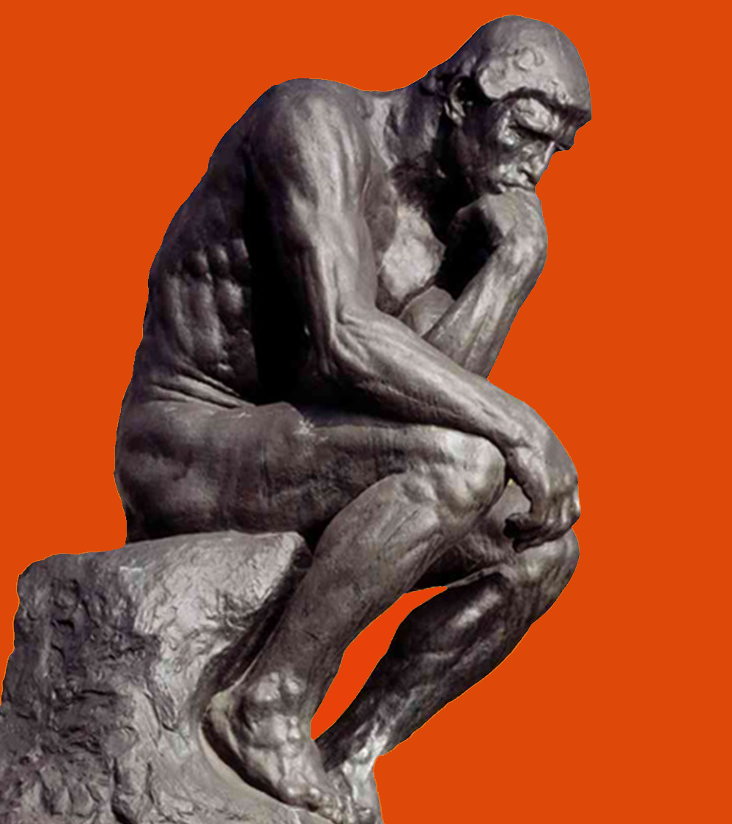

Our Problem
In Natural Language:
Find all words in a given word list within a board of randomly generated characters
Aka Word Search Puzzle

Slide 3
Our Problem: Stated Formally
Variables:
B_{i, j} = matrix of letters comprising game board, i & j indicate position
W_{L} = List of words to find ex: [w₁, w₂, w₃, w₄, …]
W = a unique sequence of M alphabetic characters
M = number of characters in a word
N = number of characters in a sequence
S = sequence of characters for any w ϵ W_{L}
D = list of directions
[up, down, left, right, down-left, down-right, up-right, up-left]

Slide 4
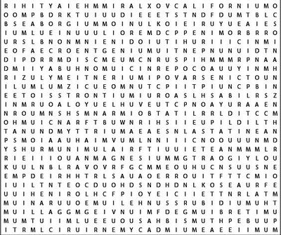

Formal Statement
Alabama
Alaska
Arizona
Arkansas
California
Colorado Connecticut
“For all words W in word list W_{L} such that the first character in Word w_{k} exist in the Board B at some given coordinate (i,j)…
{
AND
B
The sequence S_{k} of word w_{k} is equal to sequence S_{o} where S_{o} is all combinations of sequences around B_{i, j}”
W_{L}
If this statement returns true, the word w_{k} exist in board B
{∀ w ϵ W_{L} | (w_{k}[0] B_{i, j}) ∩ (S_{k} = B_{i, j} + (S_{k}-S_{k}[0]) ∀ D_{e} ϵ D | N_{k} = M_{k})} = T/F
This Photo by Unknown Author is licensed under CC BY-NC

Slide 5

Our Algorithms
Brute
Force
Boyer-Moore
Bear Method
Rabin–Karp

Slide 6
Brute Force Algorithm
The Brute Force algorithm will be the most naïve algorithm we use
For this algorithm, we will grab a word and then proceed to check every character on the board for a match and if a match occurs we will then check all 8 directions around the given character to see if the word exist. This process will be done for each word in our list of words.
for word in WordList
for row in Board
for col in Board
if word[0] == Board[row][col]
for direction in Directions
while letterCount < wordLength
#do some logic
Example for finding the first word; White.
Word Bank
WHITE BLUE RED
R N A O E
N C Z T E
C W I U K
Y H L H S
W B D E R

Slide 7
Boyer-Moore Algorithm
Developed by Robert S. Boyer and J Strother Moore in 1977.
Useful for instances where the pattern (word) is much shorter than the text (word search grid)
Needs to preprocess data before continuing with the algorithm:
Change the grid into a string for each direction
Bad character heuristic
Good suffix heuristic
O(mn) complexity

Slide 8
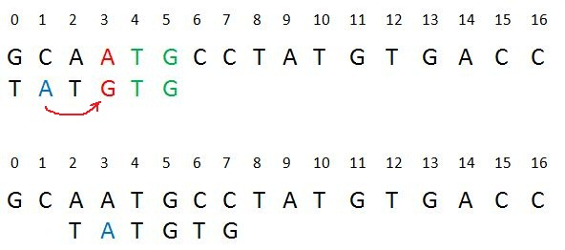
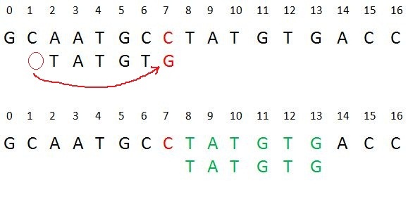
Bad character Heuristic
Preprocessing creates a 2d table which is indexed by the character in the alphabet and also indexed by the occurrence in the pattern.
Once a mismatch occurs, the next occurrence of the mismatched character to the left in the word is found.
If found, it brings that letter in line with the mismatched character.
If not found, it moves the word past the mismatched character.

Slide 9
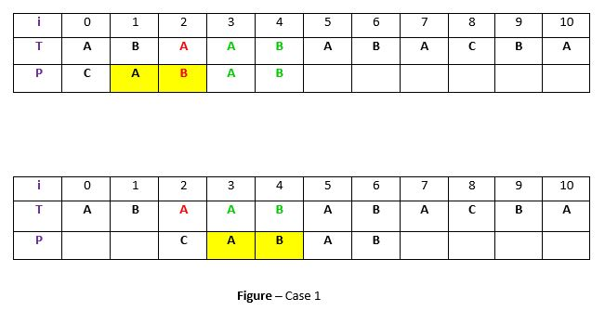
Good Suffix Heuristic
More complex than the bad character heuristic
Good suffix is the reason comparisons begin at the end rather than the start

Slide 10
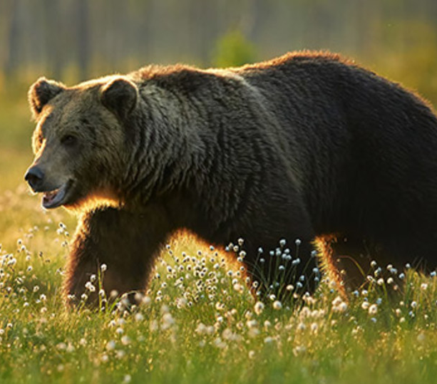
The Bear Method
The bear method uses hash maps to group letters and remember their coordinate locations on the board.
With this information, the algorithm only has to iterate through a hash map when looking for the current word.
Side Note:
This method got its name from bears because of their excellent long-term memory.

Slide 11
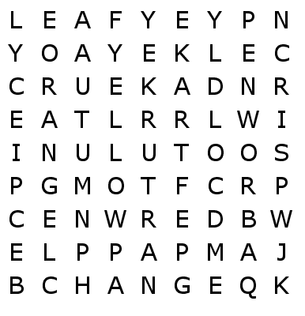








The Bear Method (Continued)
Before searching for solutions, this algorithm will generate hash maps for each letter of the alphabet and store it’s coordinate position.
(Example)→
With hash maps, for each solution, the algorithm will use exactly one for loop which will use hash map searches.
Key | Value
(1,3) | A
(2,3) | A
(3,6) | A
(4,2) | A
(8,5) | A
(8,8) | A
(9,4) | A
Find: ART

Slide 12
Rabin–Karp Algorithm
Uses hashing to find any one of a set of pattern strings in a text
The algorithm slides the pattern one by one and matches the hash value of the pattern with the hash value of the current substring of text
If the hash values match then it starts matching individual characters
Uses the fact that if 2 strings are equal their hash values are also equal

Slide 13
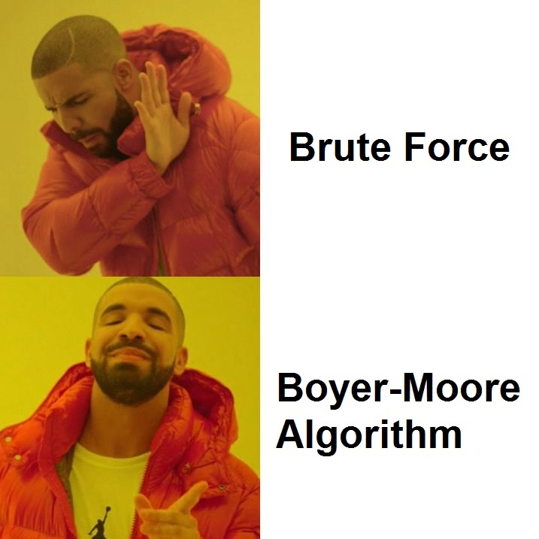
Hypothesis
We predict…
Boyer-Moore will be the most efficient algorithm when dealing with a larger data set.
That when changing the constraints to our problem, the performance of each algorithm will be affected.

Slide 14

Questions?

